Slide 1




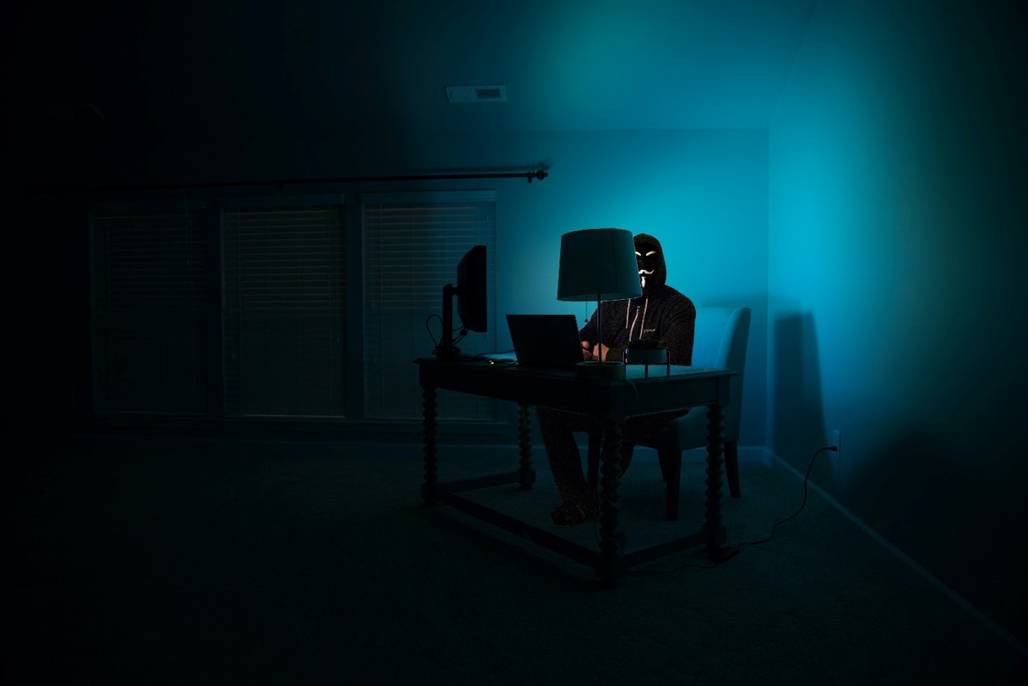
A PRESENTATION ON DARK WEB
PRESENTED BY:
SAKSHI SRIVASTAVA
CSE 3RD YEAR
2110013135140

Slide 2

What is DARK WEB?
The dark web is a part of the internet that isn't indexed by search engines. You've no doubt heard talk of the “dark web” as a hotbed of criminal activity and it is. Researchers Daniel Moore and Thomas Rid of King's College in London classified the contents of 2,723 live dark web sites over a five-week period in 2015 and found that 57% host illicit material.
A 2019 study, Into the Web of Profit, conducted by Dr. Michael McGuires at the University of Surrey, shows that things have become worse. The number of dark web listings that could harm an enterprise has risen by 20% since 2016. Of all listings (excluding those selling drugs), 60% could potentially harm enterprises.
You can buy credit card numbers, all manner of drugs, guns, counterfeit money, stolen subscription credentials, hacked Netflix accounts and software that helps you break into other people’s computers. Buy login credentials to a $50,000 Bank of America account, counterfeit $20 bills, prepaid debit cards, or a “lifetime” Netflix premium account. You can hire hackers to attack computers for you. You can buy usernames and passwords.
1

Slide 3
DARK WEB BROWSER
All this activity, this vision of a bustling marketplace, might make you think that navigating the dark web is easy. It isn’t. The place is as messy and chaotic as you would expect when everyone is anonymous, and a substantial minority are out to scam others.
Accessing the dark web requires the use of an anonymizing browser called Tor. The Tor browser routes your web page requests through a series of proxy servers operated by thousands of volunteers around the globe, rendering your IP address unidentifiable and untraceable. Tor works like magic, but the result is an experience that’s like the dark web itself: unpredictable, unreliable and maddeningly slow.
Still, for those willing to put up with the inconvenience, the dark web provides a memorable glimpse at the seamy underbelly of the human experience – without the risk of skulking around in a dark alley.
2

Slide 4
DARK WEB WEBSITE
Dark web websites look pretty much like any other site, but there are important differences. One is the naming structure. Instead of ending in .com or .co, dark web websites end in .onion. That’s “a special-use top level domain suffix designating an anonymous hidden service reachable via the Tor network,” according to Wikipedia. Browsers with the appropriate proxy can reach these sites, but others can’t.
Dark web websites also use a scrambled naming structure that creates URLs that are often impossible to remember. For example, a popular commerce site called Dream Market goes by the unintelligible address of “eajwlvm3z2lcca76.onion.”
Many dark websites are set up by scammers, who constantly move around to avoid the wrath of their victims. Even commerce sites that may have existed for a year or more can suddenly disappear if the owners decide to cash in and flee with the escrow money they’re holding on behalf of customers.
3

Slide 5
ADVANTAGES
The dark web helps people to maintain privacy and freely express their views. Privacy is essential for many innocent people terrorized by stalkers and other criminals. The increasing tendency of potential employers to track posts on social media can also make it difficult to engage in honest discussions publicly. Finally, the popularity of the dark web with criminals makes it a perfect way for undercover police officers to communicate.
One of the biggest advantages of the dark web is the difficulty of blocking it. Common forms of censorship, which block traffic to websites at specific choke points along the Internet hierarchy, do not work with encrypted overlay networks. For similar reasons, the dark web is more resistant to surveillance by governments and corporations. Whistle blowers, journalists, and other professionals at risk of targeted surveillance use the dark web to communicate sensitive information. And organizations including Human Rights Watch and the Electronic Frontier Foundation support the use of and access to the dark web.
4

Slide 6

5

Slide 7
DISADVANTAGES
The dark web empowers ordinary people, but some people will inevitably abuse that power. The dark web can make it easier to commit some of the worst crimes. For example, the combination of the dark web and cryptocurrencies theoretically makes it much easier to hire someone to commit a murder. While the dark web promises privacy to its users, it can also be used to violate the privacy of others. Private photos, medical records, and financial information have all been stolen and shared on the dark web.
6

Slide 8
USES
A Hidden Service (also known as an ‘onion service’) is one where not only the user, but also the website itself, have their anonymity protected by Tor. This means that the IP address of the site cannot be identified, meaning that information about its host, location or content is hidden. Hidden Services are sometimes called “onion addresses” because the website name often ends .onion. The Dark Web may be used by people wishing to carry out illegal activities online, such as selling weapons or drugs. These kinds of operations, and the websites offering them, are often referred to as Hidden Services
13

Slide 9
References
www.investopedia.com
www.wikipedia.com
www.slideshare.net
14

Slide 10
Thank you!
15

